Slide 1

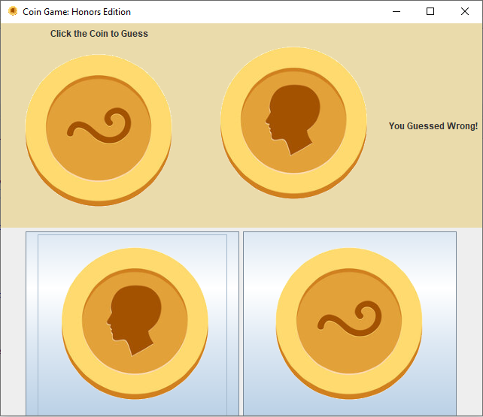
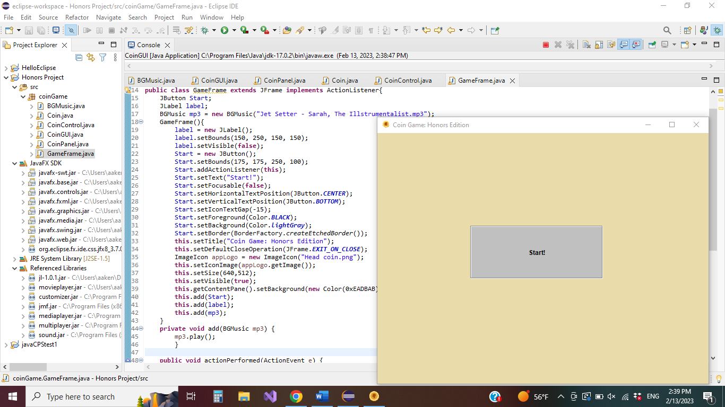
Java Coin Flip Game
Amonie Akens
College of
Mathematics & Computer Science
Department of Mathematics & Computer Science, Central State University
Research Mentors: Dr. Deng Cao
Application
Overview
Discussion
C
This application is a Java Graphical User Interface (GUI) program that also includes background music. The user can start the game, then guess the coin by clicking one of the face buttons.
Unlike a basic, single class coin flip program, a coin flip GUI requires a more complex series of classes. The planned functions of this game required extra Java archive files (JARs). While the program is complex, each class contains elements to make the program user friendly.
Certain tasks in Java require additional JAR files. This program utilized JavaFX and Java Zoom. Using multiple JAR libraries can be difficult if not sequenced correctly. Through trial and error, a Java Zoom mp3 player was successfully added to the JavaFX GUI. Future editions could include a mp4 video player of a coin flipping.
Program
Methods
Utilizes six classes:
Coin GUI Class: Calls foundational game frame for Program.
Game Frame Class: Organizes and executes all the necessary classes for GUI in a window.
Music Player Class: Plays mp3 files via Java Zoom JAR.
Coin Class: Sets framework of coin game generation and output.
Coin Panel Class: Presents majority of GUI visible elements such as text and PNG images. This where these elements are repainted each flip.
Coin Control Class: Receives user interaction via buttons.

